Slide 1


M. KUMARASAMY COLLEAGE OF ENGINEERING KARUR
DEPARTMENT OF ELECTRONIC AND COMMUNICATION ENGINEERING
MICROCONTROLLER INTERFACING
END SEMESTER PROJECT REVIEW
PREPARED BY :
HARI PRASATH R

Slide 2
ACCIDENT ALERT AND LOCATION TRACKING SYSTEM USING GPS AND GSM

Slide 3
ABSTRACT
Road accidents are a major cause of fatalities worldwide, and immediate medical assistance can significantly reduce the severity of injuries. This project presents an Accident Alert and Location Tracking System that utilizes GPS (Global Positioning System) and GSM (Global System for Mobile Communications) to detect accidents and automatically notify emergency responders, nearby hospitals, and family members.
Key Features:
Automatic Accident Detection – The system uses impact sensors to detect an accident.
Real-Time Location Tracking – GPS provides precise location data of the accident spot.
Instant Notifications – GSM sends messages and calls to emergency contacts and hospitals.
Customizable Contact List – Family members' contacts can be updated as needed.
Prioritized Alerts – Messages are first sent to emergency services, followed by family members for quick response.

Slide 4
PROBLEM ANALYSIS
In many cases of road accidents, delay in emergency response leads to severe injuries and loss of life. The primary causes of these delays include:
Lack of immediate accident detection
Absence of real-time location tracking
No automated alert system for emergency contacts and hospitals
To address these issues, an Accident Alert and Location Tracking System using GPS and GSM can be implemented. This system will detect accidents using sensors, retrieve the accident location via GPS, and send instant alerts through SMS and phone calls to family members, nearby hospitals, and ambulance services. Additionally, it will provide an option to update emergency contact numbers easily for improved flexibility. This system will ensure quick response times, potentially saving lives by reducing delays in medical assistance.

Slide 5
OBJECTIVE
To develop an Accident Alert and Location Tracking System using GPS and GSM that can detect accidents and automatically notify emergency services (ambulance, nearby hospitals) and family members through SMS and phone calls. The system will provide the precise location of the accident, ensuring quick response and medical assistance.
Additionally, the system will allow easy customization of family notifications so that only designated family members receive alerts. The system will focus on detecting accidents in nearby locations and ensuring timely intimation for effective emergency response.

Slide 6
LITERATURE SURVEY
1. Patil, K. N., et al. (2015) proposed a GPS and GSM-based vehicle accident detection system that sends location information to emergency contacts through SMS. The system used vibration and tilt sensors to detect accidents and demonstrated effective communication in emergency scenarios.
2. Ragavi, R., & Sivasankari, S. (2018) introduced a microcontroller-based system that detects vehicular collisions and transmits the coordinates via GSM to emergency services. Their study emphasized the reduction in response time due to automated alerts.
3. R. Kumar and M. Rajput (2019) presented a vehicle accident tracking system using GSM and GPS modules, integrated with a microcontroller and sensors. The system offered real-time tracking and improved notification reliability through call and message-based alerts.
4. Chowdhury, S., et al. (2020) explored the use of smart sensors and mobile communication networks in accident detection systems. Their findings highlighted the importance of user-customizable features and integration with traffic management networks for scalable deployment.

Slide 7
TECHNOLOGY ADOPTED
1. GPS (Global Positioning System): Used to obtain real-time geographical coordinates (latitude and longitude) of the accident location for precise tracking.
2. GSM (Global System for Mobile Communication): Enables sending SMS messages and making phone calls to emergency contacts, including hospitals, ambulances, and family members.
3. Microcontroller (e.g., Arduino UNO): Acts as the central control unit that processes sensor data, retrieves GPS coordinates, and triggers GSM communication upon detecting an accident.
4. Vibration Sensor (e.g., SW-420): Detects sudden shocks or impacts, serving as the primary sensor for identifying potential collisions or accidents.
5. Buzzer and Reset Button: The buzzer provides an audio alert upon accident detection, while the reset button allows the user to cancel false alerts.
6. Power Supply Unit: Provides consistent electrical power to all components, ensuring uninterrupted operation of the system.

Slide 8
EXISTING SYSTEM
1. IoT Based Accident Detection and Vehicle Tracking System Using GPS and GSM Module
This system uses a vibration sensor with Arduino to detect accidents and sends GPS location via GSM to emergency contacts. Data is also uploaded to an IoT platform for real-time monitoring and faster emergency response.
2. Design & Development of Arduino Based Vehicle Accident Alert System Using GPS, GSM Module, Distance & Force Sensor
An Arduino-based system that uses force and distance sensors to accurately detect and prevent accidents. It sends GPS coordinates via GSM and displays status on an LCD for enhanced reliability.
3. Vehicle Accident Alert System Built Using Arduino, GPS, And A GSM Module
A low-cost accident detection system using an accelerometer, GPS, and GSM with Arduino. It is simple, beginner-friendly, and effective for educational or small-scale applications.

Slide 9
COMPONENTS REQUIRED
Arduino Uno/Nano
GPS Module Neo-6M
GSM Module SIM800L
Vibration Sensor (SW-420) (for accident detection)
Buzzer (for alert sound)
Push Button (to reset system if false alert is triggered)
Power Supply (Battery/Adapter 9V-12V)

Slide 10
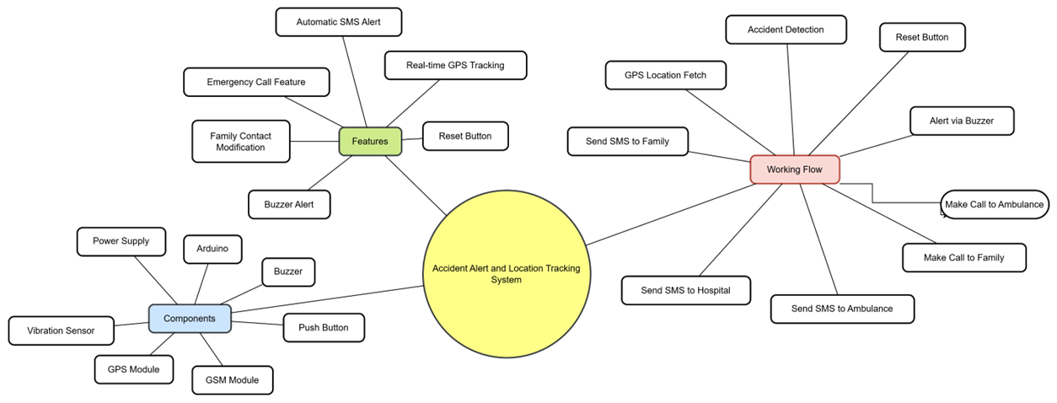
MIND MAP

Slide 11
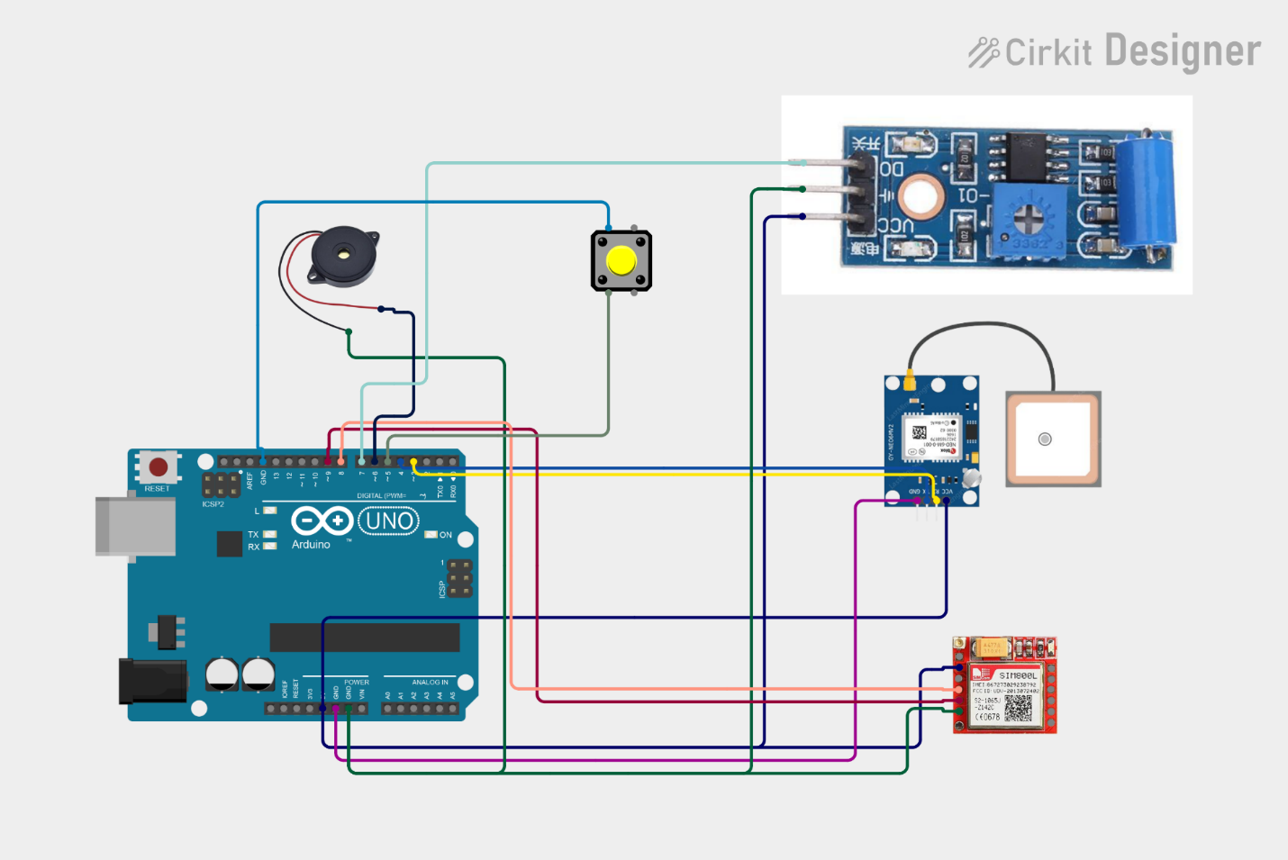
CIRCUIT DIAGRAM

Slide 12
FEATURES & ENHANCEMENTS:
✅ Real-time GPS Tracking
✅ Automatic SMS Alert with Location
✅ Emergency Call Feature
✅ Family Contact Easily Changeable
✅ Buzzer Alert for Awareness
✅ Reset Button to Avoid False Alarms

Slide 13
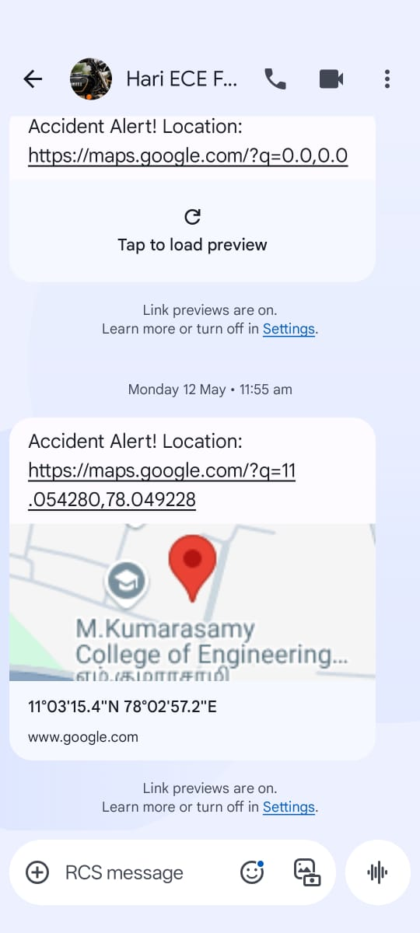

SOLUTION AND RESULT
SMS Message
Phone Call

Slide 14
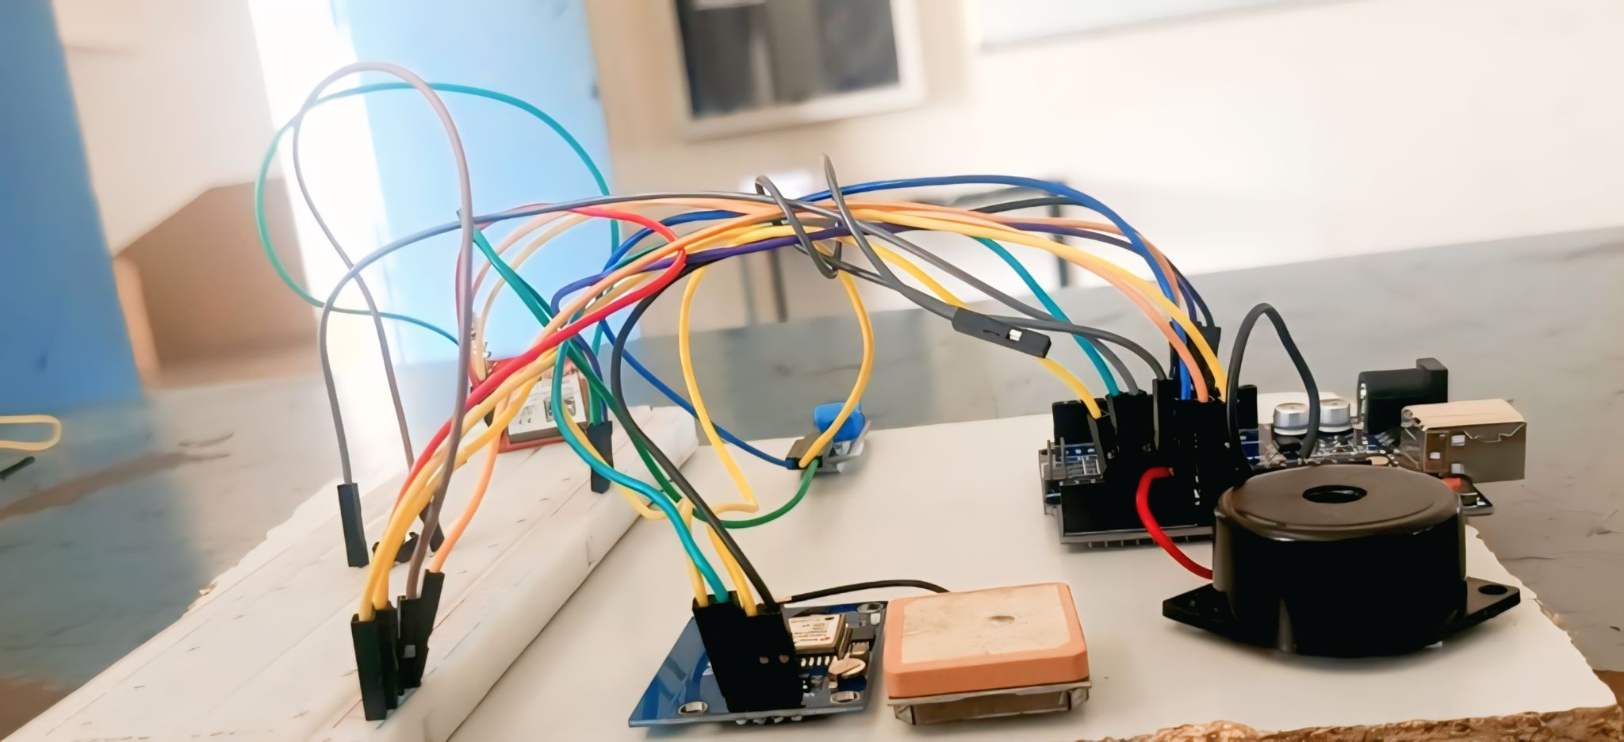
REALTIME PHOTO

Slide 15
REFERENCES
"Accident Detection and Alert System Using GPS and GSM" International Journal of Creative Research Thoughts (IJCRT), 2022. This paper discusses an automatic alert system for vehicle accidents that sends messages to registered mobile numbers using wireless communication techniques.
https://youtu.be/WNezQ0maD9I?si=IbAerBdy4qV7r_Uu
https://ajast.net/data/uploads/72031.pdf

Slide 16
CONCLUSION
The Accident Alert and Location Tracking System using GPS and GSM provides an effective and reliable solution for enhancing road safety and emergency response. By automatically detecting accidents and immediately notifying emergency contacts with real-time location information, the system significantly reduces response time and increases the chances of saving lives. The integration of SMS alerts, phone calls, and customizable contact settings ensures timely and personalized communication during critical situations. Overall, this system serves as a valuable tool in minimizing the consequences of road accidents and offers a practical step toward smarter and safer transportation infrastructure.

Slide 17
THANK YOU

